Slide 1



Bus Ticket Booking
And
Pass System
Bus Ticket Booking
And
Pass System

Slide 2


Bus Ticket Booking and Pass System
Introduction
Input Output design
Project Profile
Testing
System requirement and specification
Limitation
Diagram
Future Scope
Data Dictionary
Conclusion

Slide 3
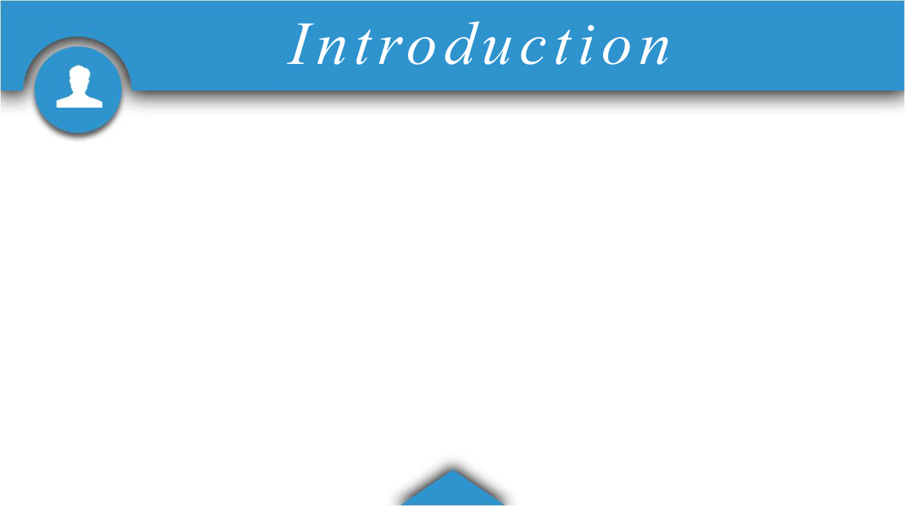

Project Name Bus Ticket Booking And Pass System
Group Id 14
Sharvil Shah 3068
Jeet Khatri 3194
Avnish Thakkar 3242
Internal Guide Kalyani Patel
1

Slide 4


2

Slide 5
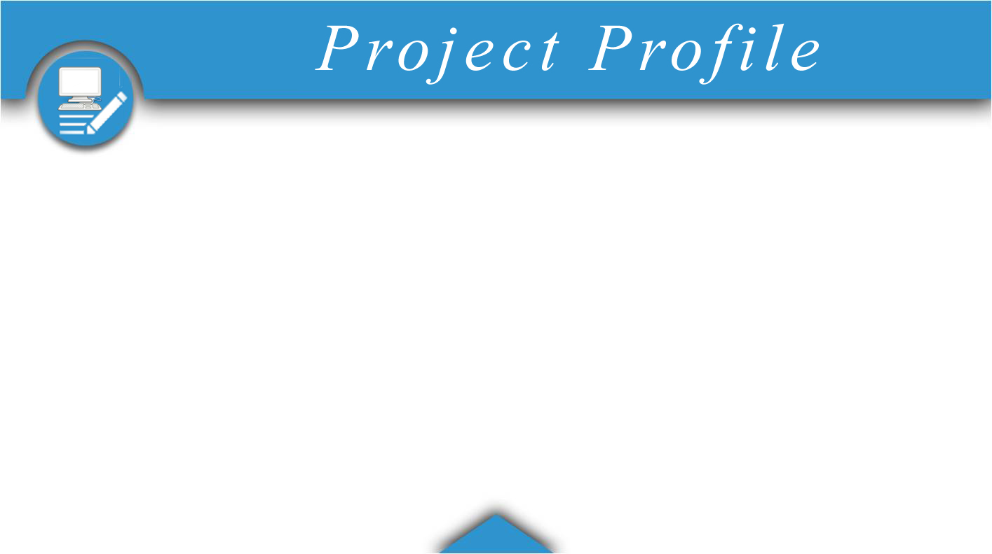


Project Definition
In this website people can see the regular schedule of bus ,can book the ticket of bus and also they can have pass from website.
3

Slide 6
Current System
People need to ask(by phone) for schedule or have to visit particular place
People have to book ticket manually
Pass is manually obtained
4

Slide 7
Proposed System
People can see schedule anytime
People can book, cancel ticket and select desired seats
People can get pass online
5

Slide 8


6

Slide 9
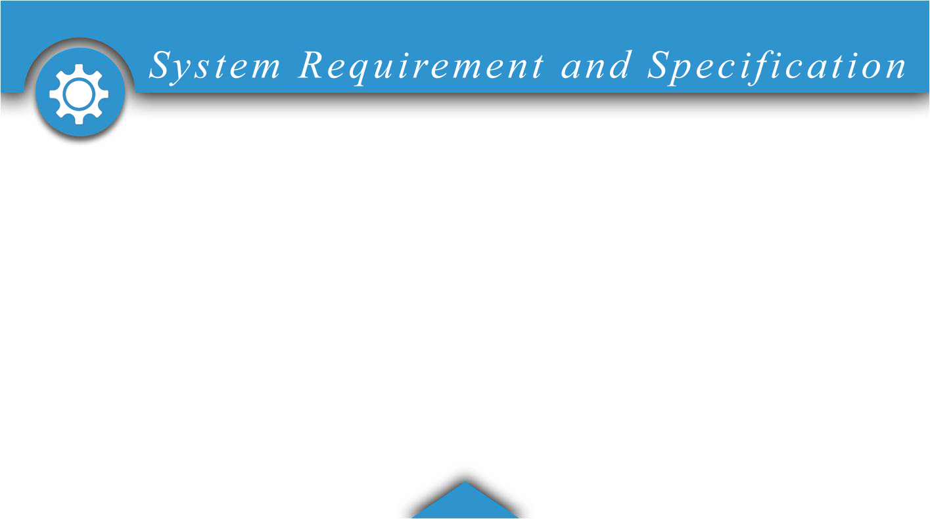
Hardware Requirement
Processor : Minimum Pentium 4
RAM : 256 MB or more
OS : Minimum Windows XP
Web server
Apache Tomcat
Backend Technology
MySQL
Backend Tools
MySQL Command line version
Architecture Followed : MVC
7

Slide 10

Technologies Used
Frontend Technology
JSP-Servlet
HTML5
CSS
JQUERY
BOOTSTRAP
Frontend Tools
Dreamweaver 8
Photoshop CS6
Eclipse
8

Slide 11
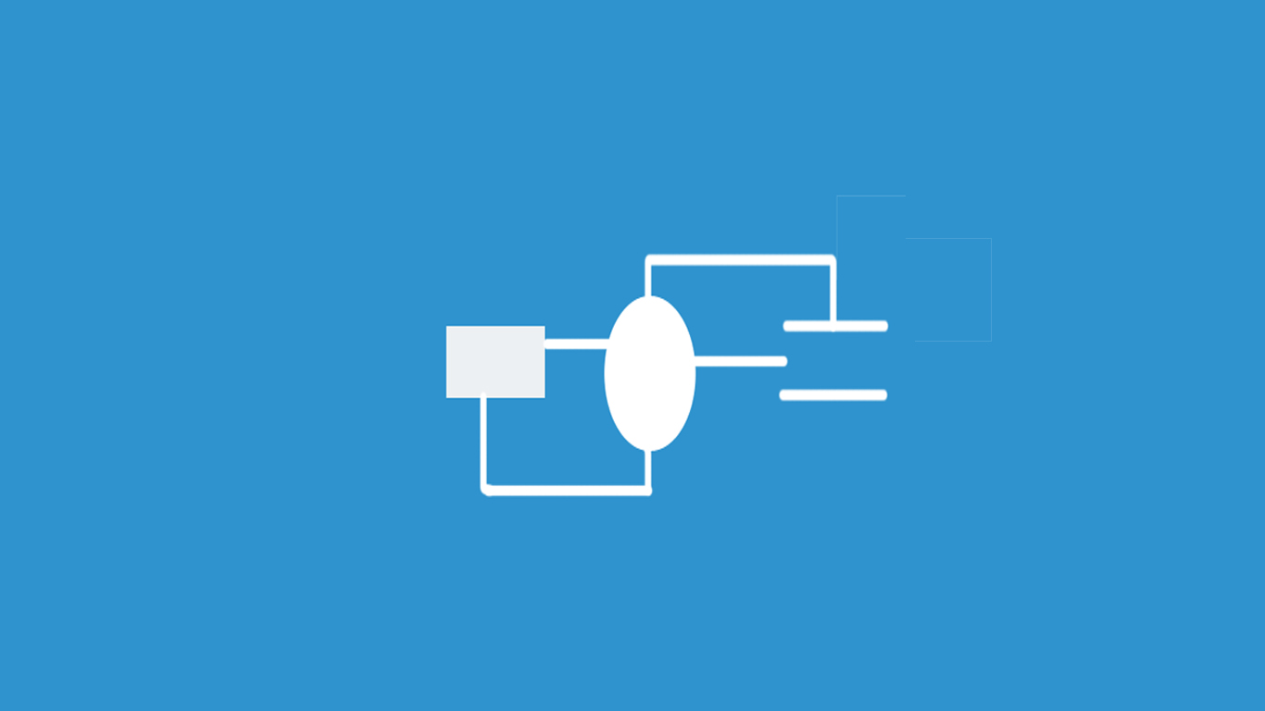
9

Slide 12
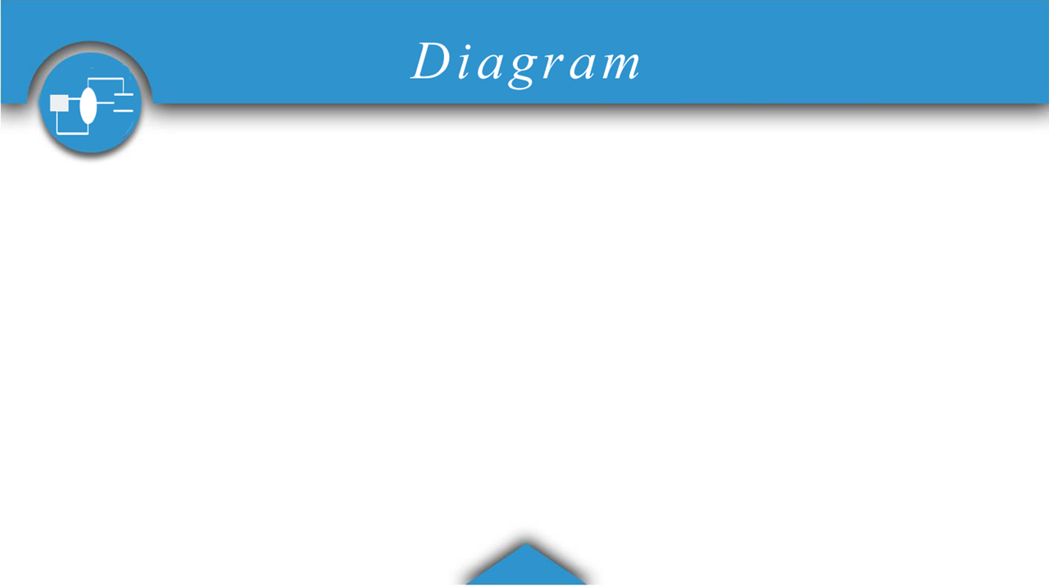
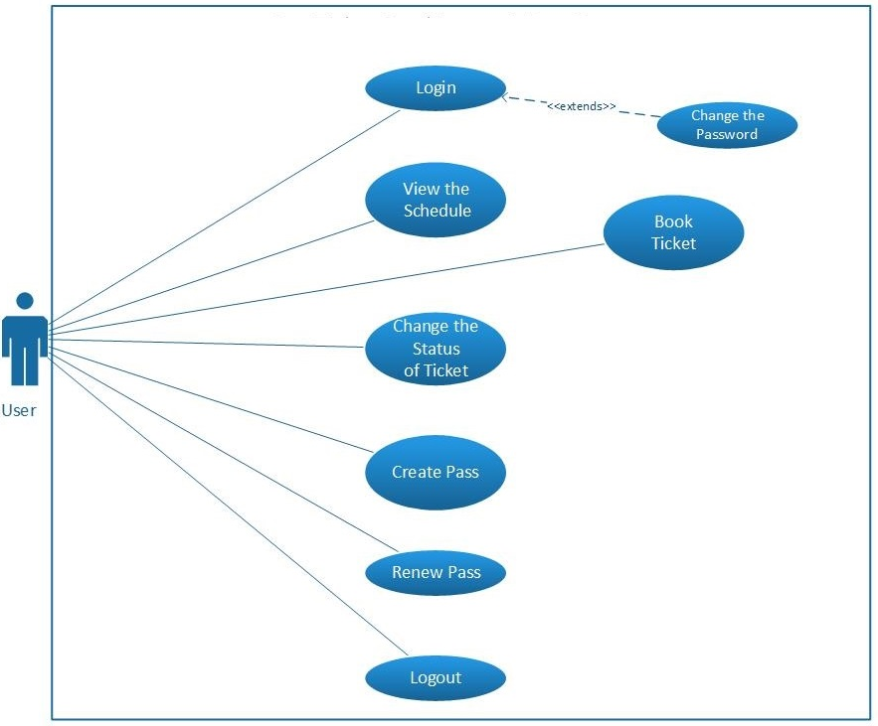
Use Case For User
10

Slide 13
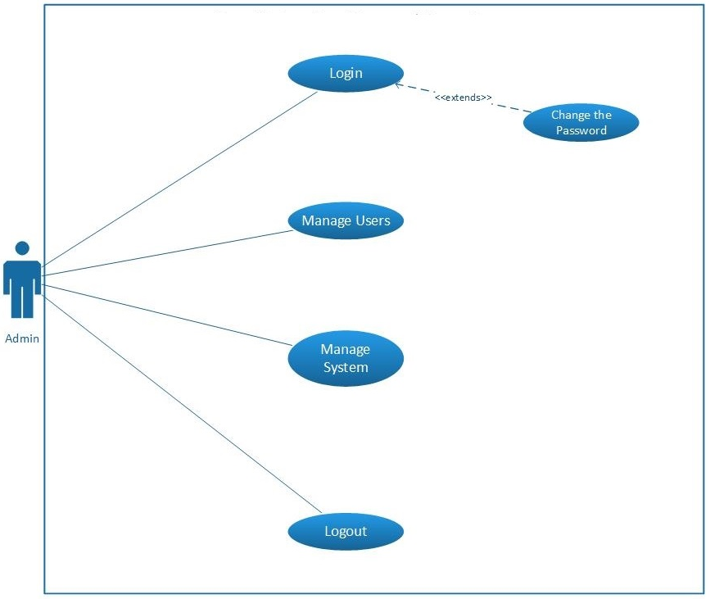
Use Case For Admin
11

Slide 14
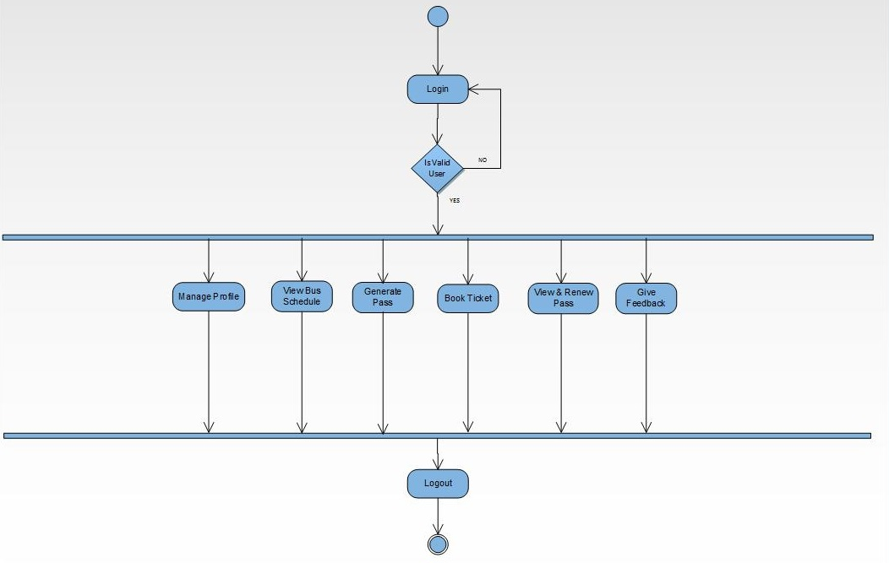
Activity Diagram For User
12

Slide 15
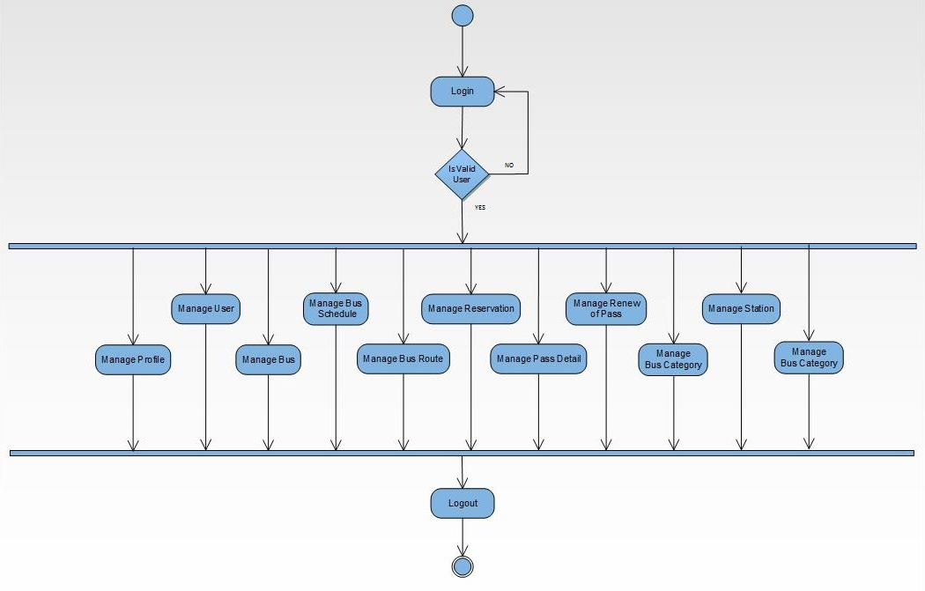
Activity Diagram For Admin
13

Slide 16
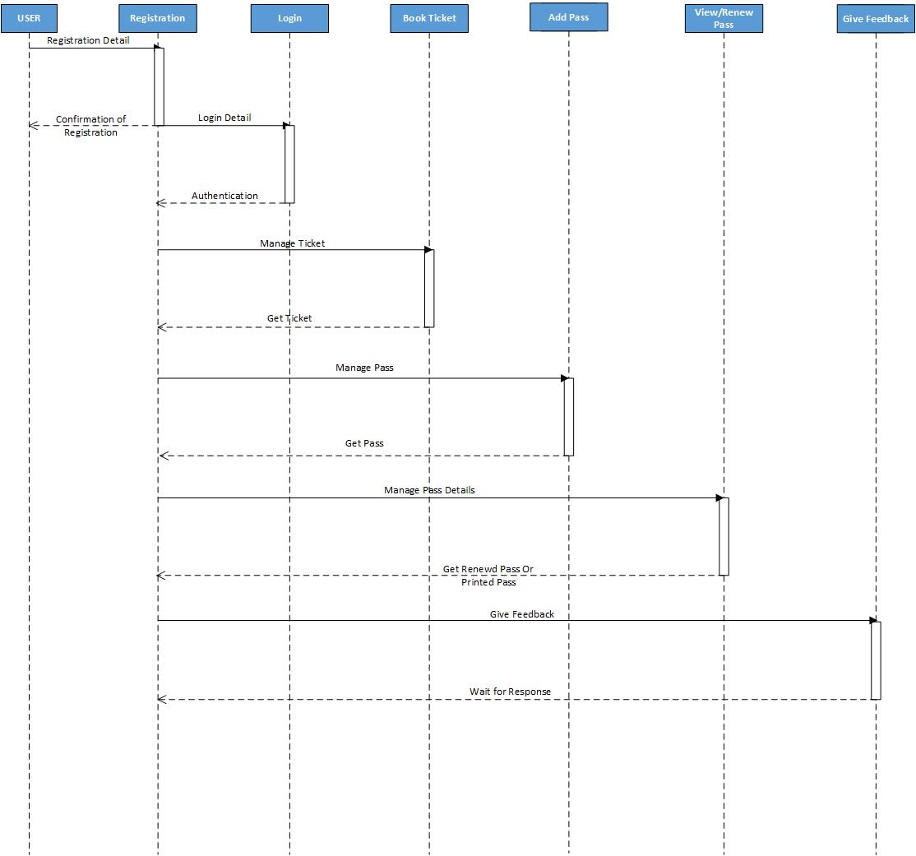
Second Level
Sequence Diagram For User
14

Slide 17
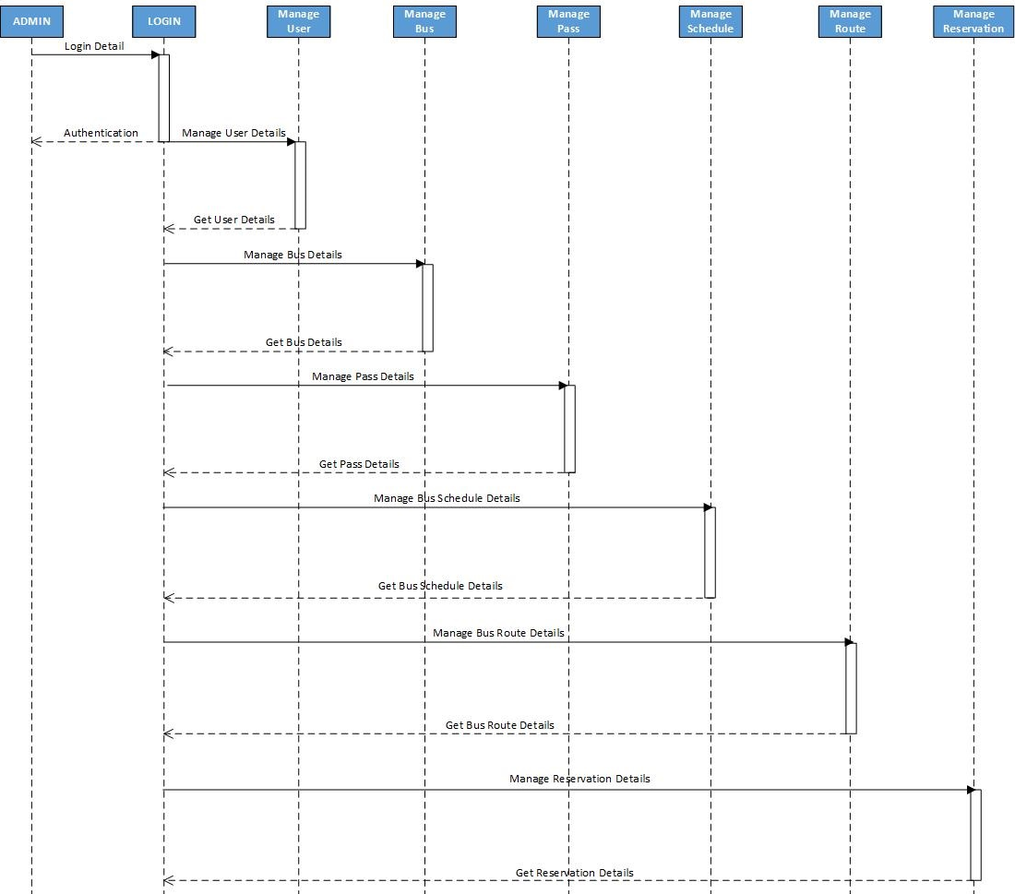
Second Level
Sequence Diagram For Admin
15

Slide 18
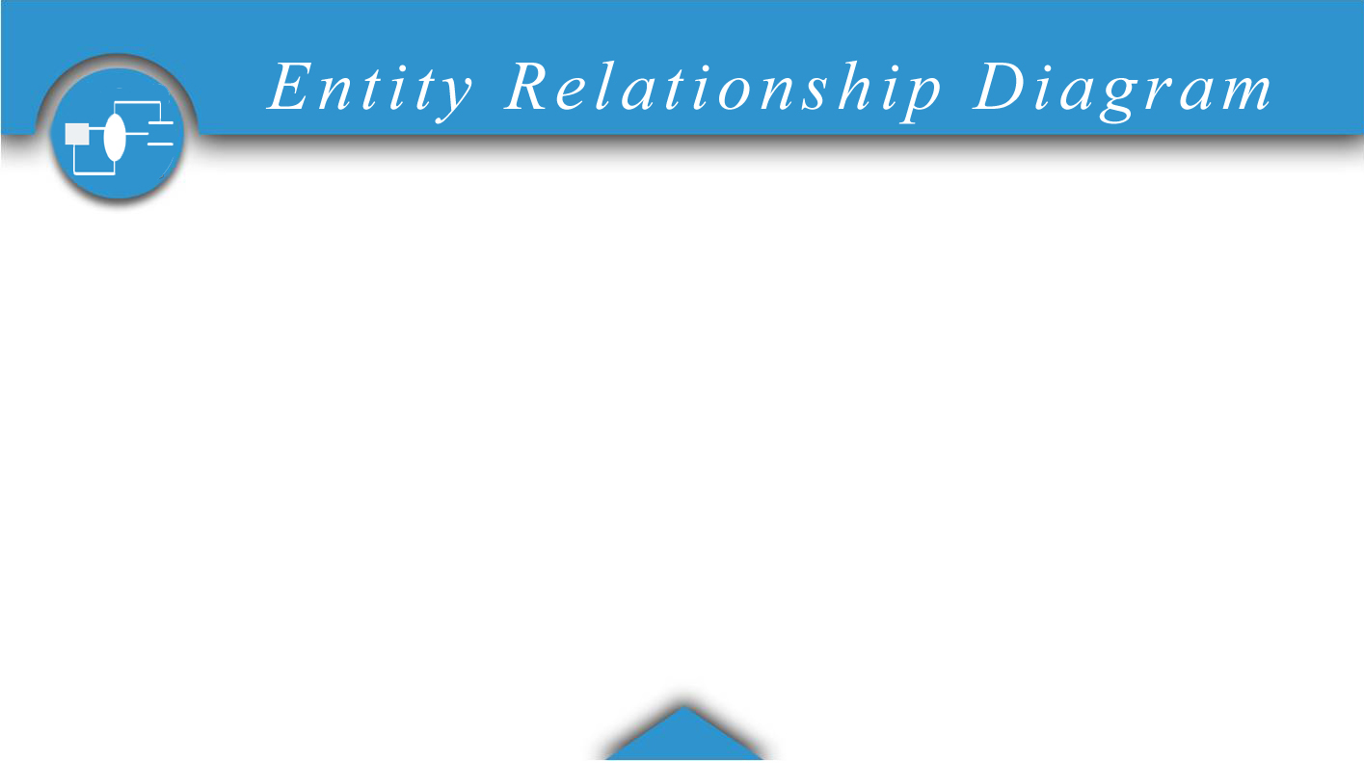
Class Diagram
16

Slide 19

17

Slide 20
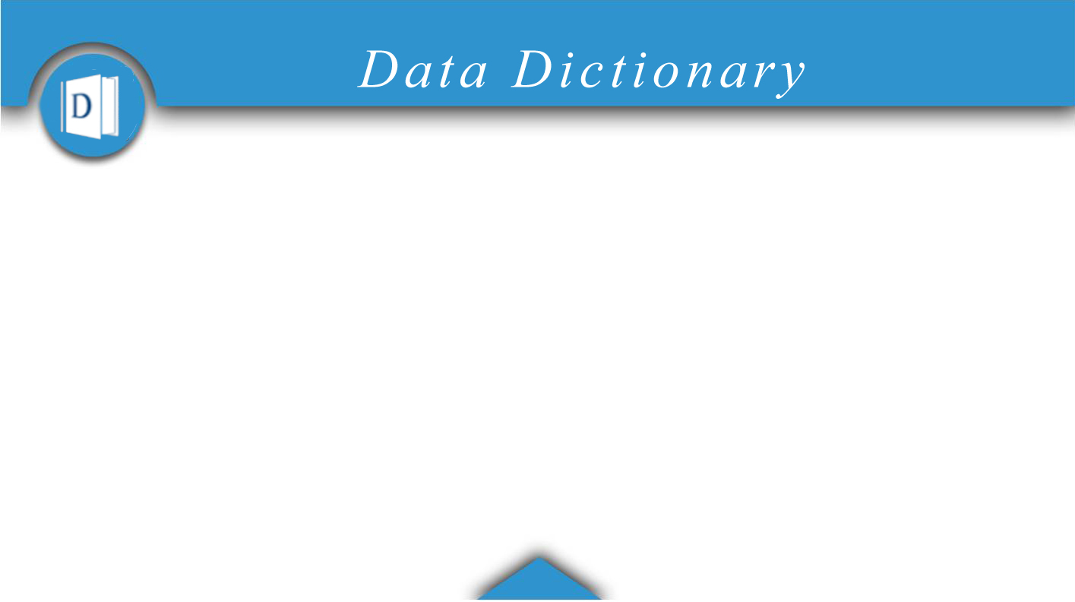
Data Dictionary
18

Slide 21

19

Slide 22
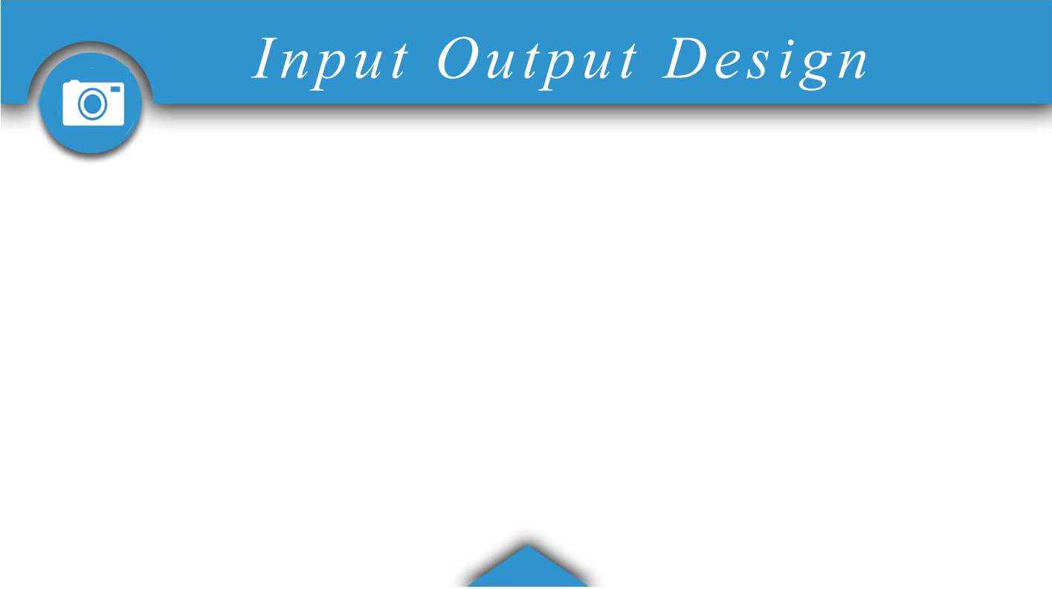
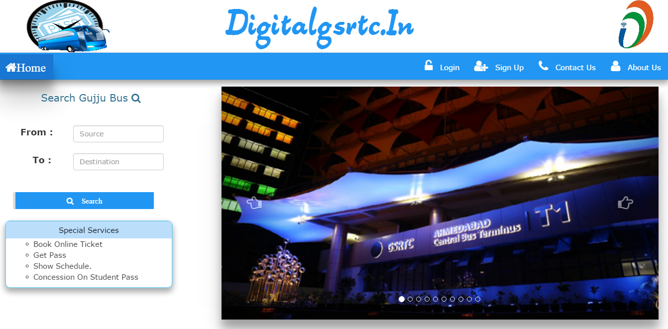
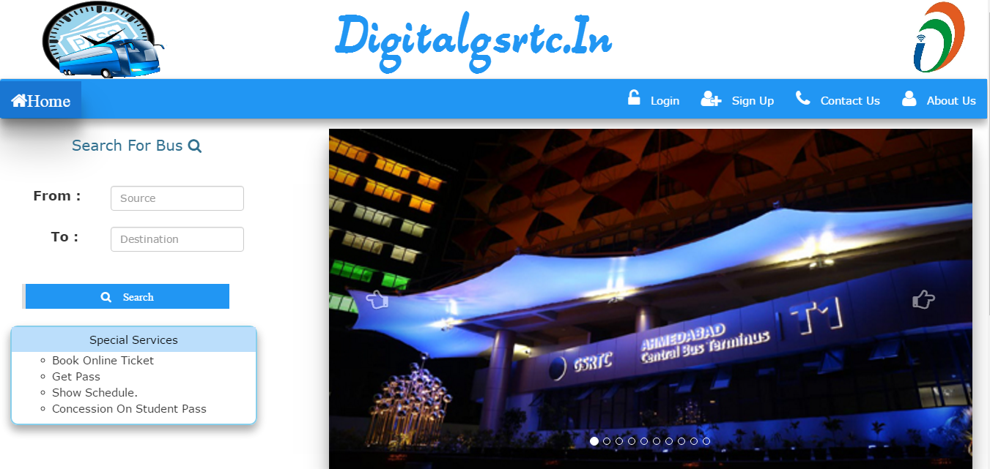
20

Slide 23
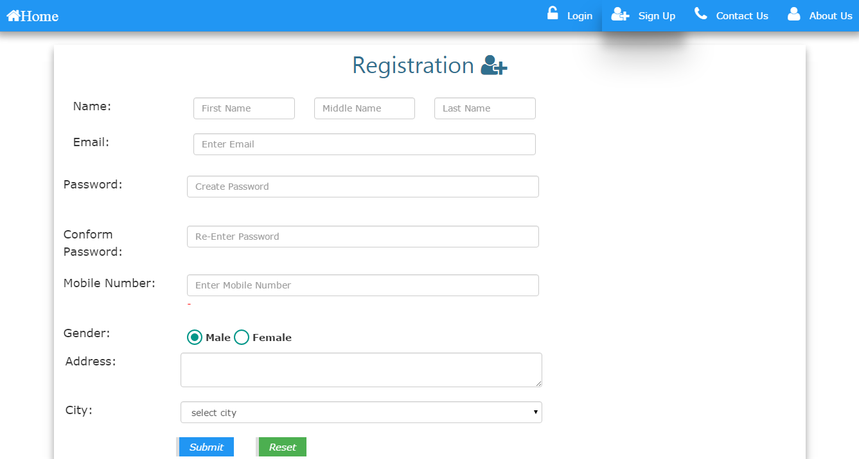
21

Slide 24
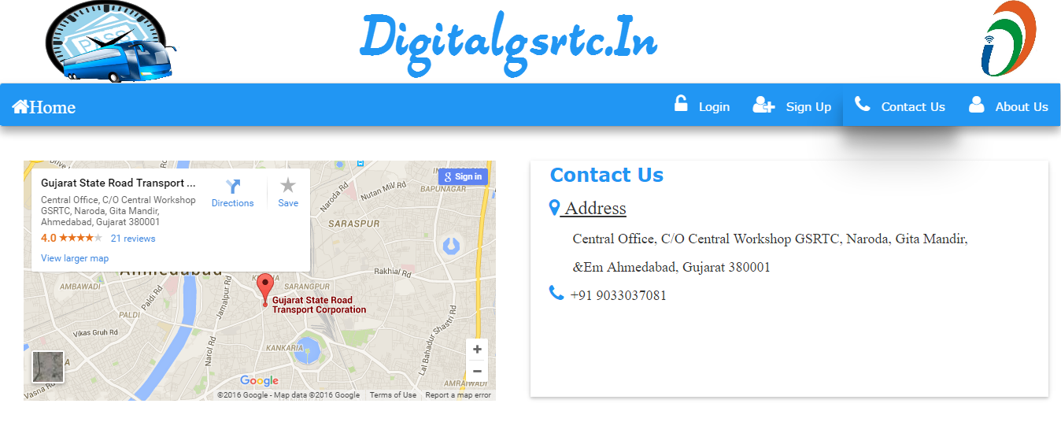
22

Slide 25
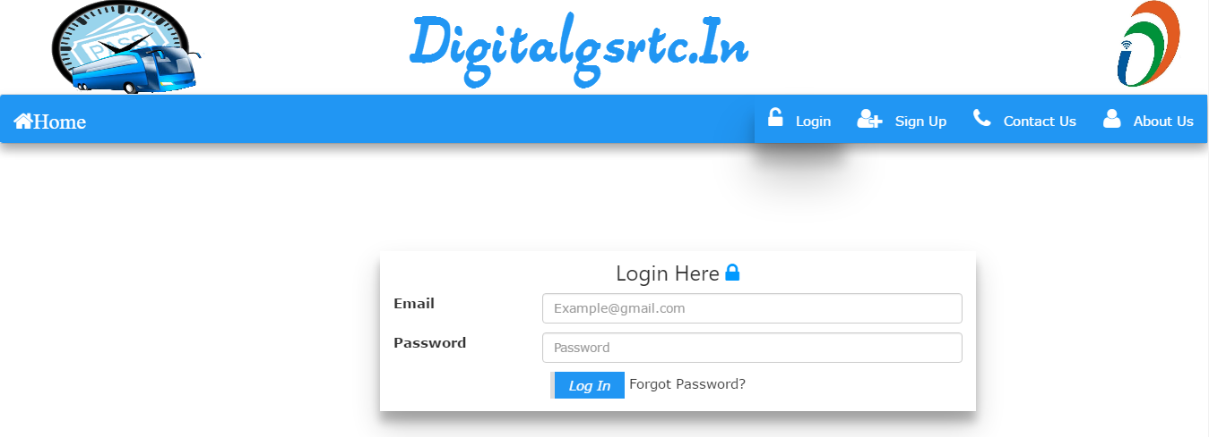
23

Slide 26
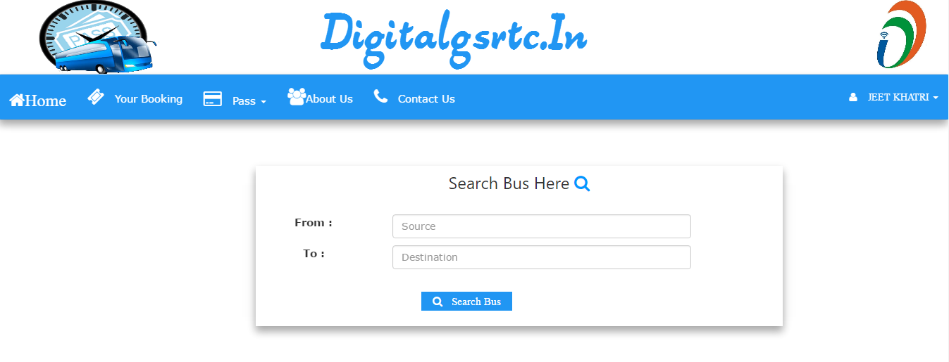
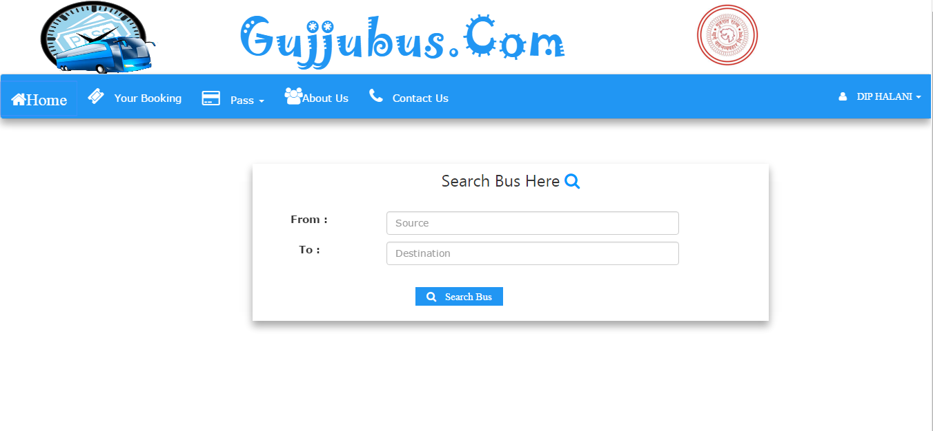
24

Slide 27
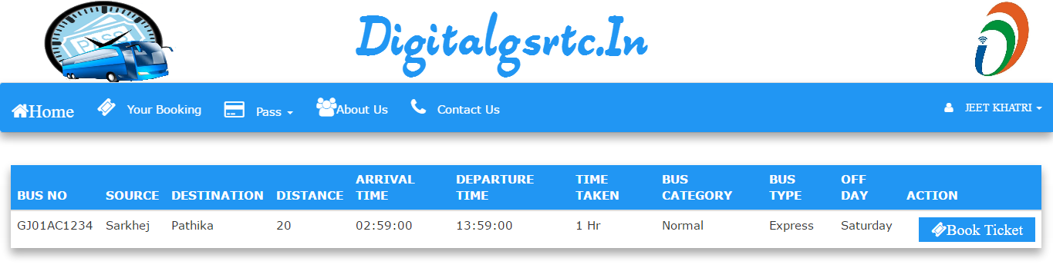
25

Slide 28
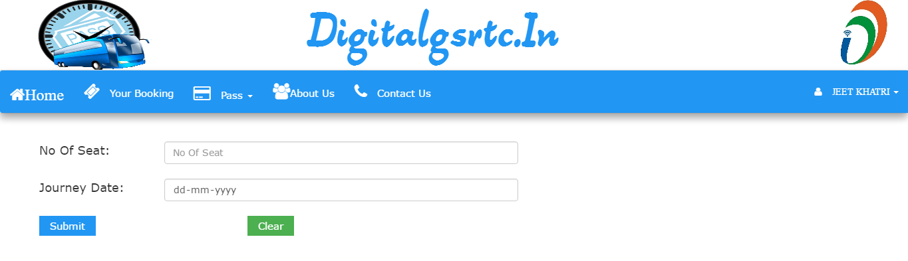
26

Slide 29
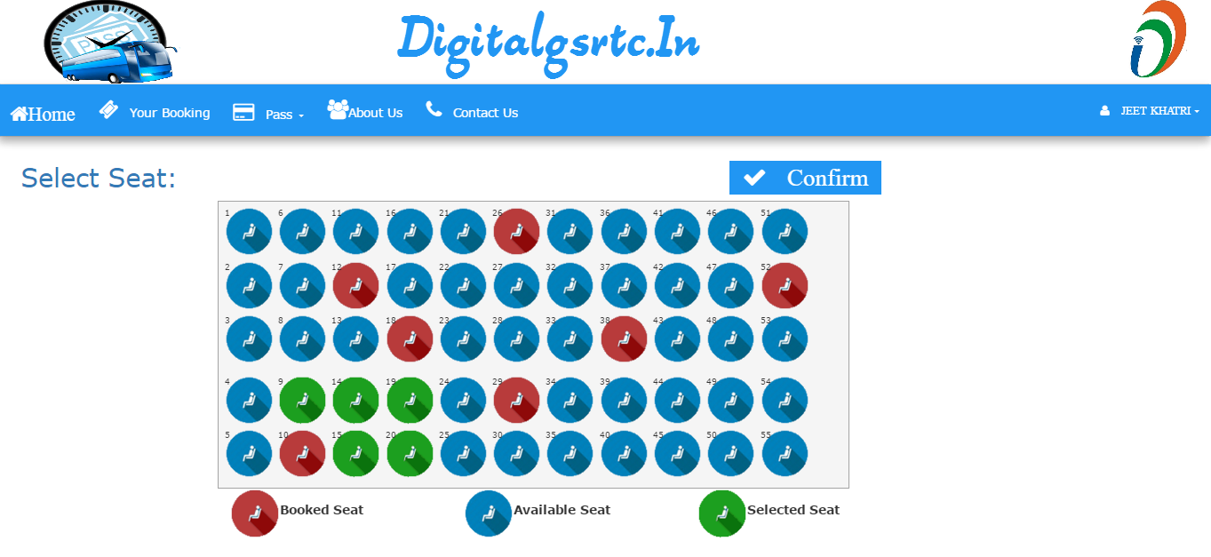
27

Slide 30
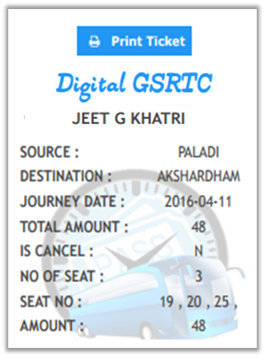
28

Slide 31
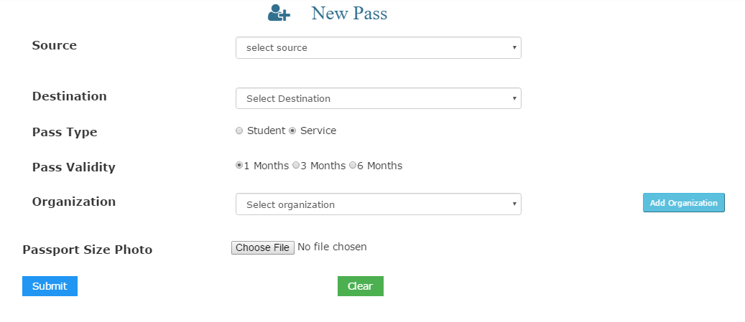
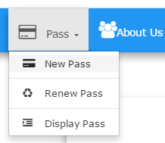

29

Slide 32
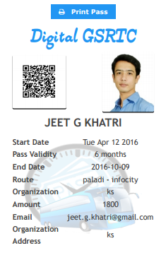
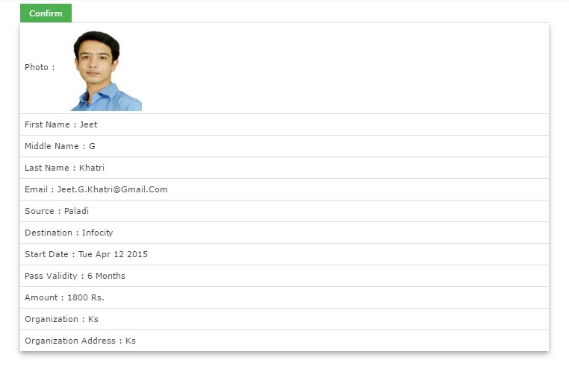
30

Slide 33
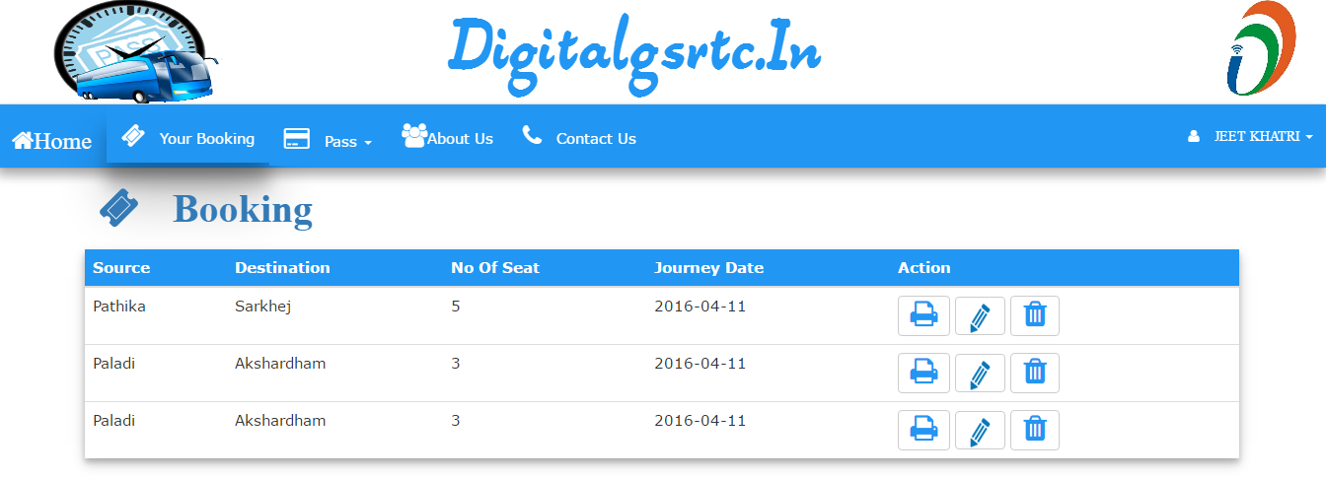
31

Slide 34

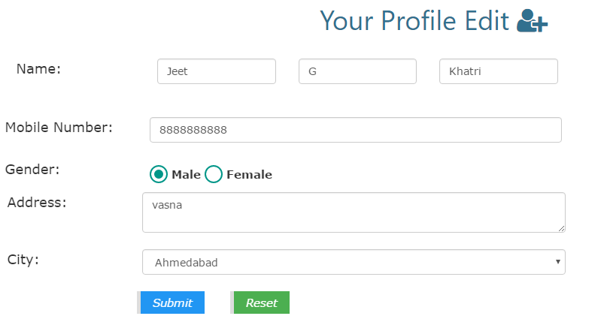
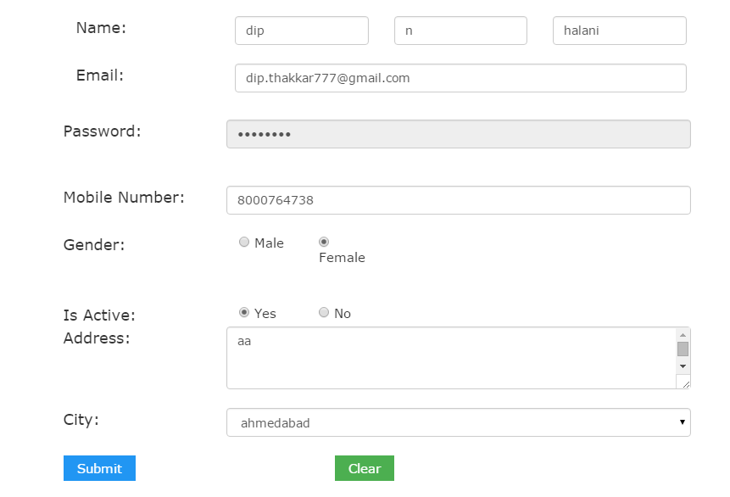
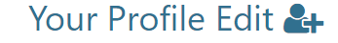
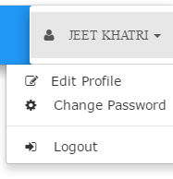
32

Slide 35
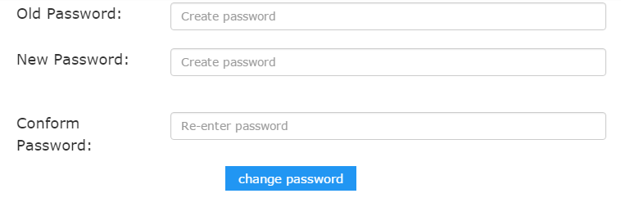
33

Slide 36
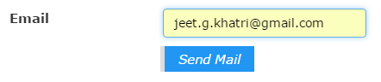
Step 1
34

Slide 37
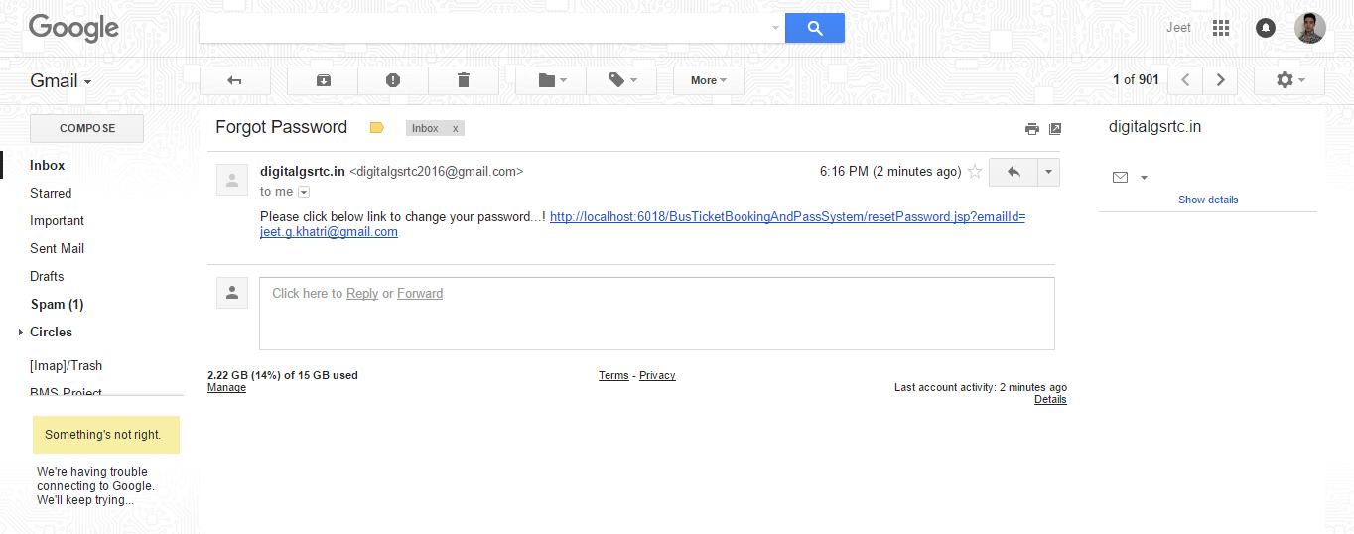
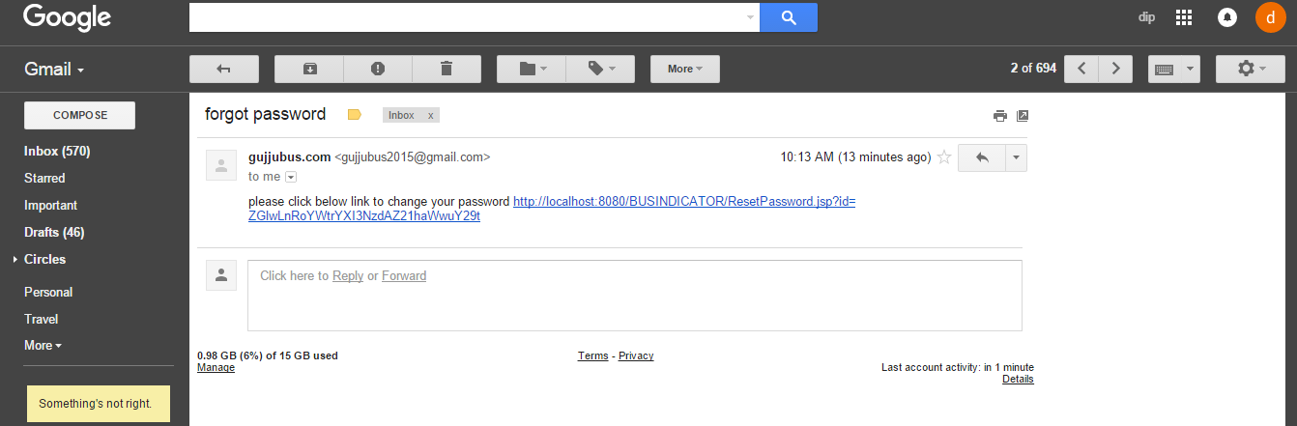
Step 2
35

Slide 38
Step 3
36

Slide 39
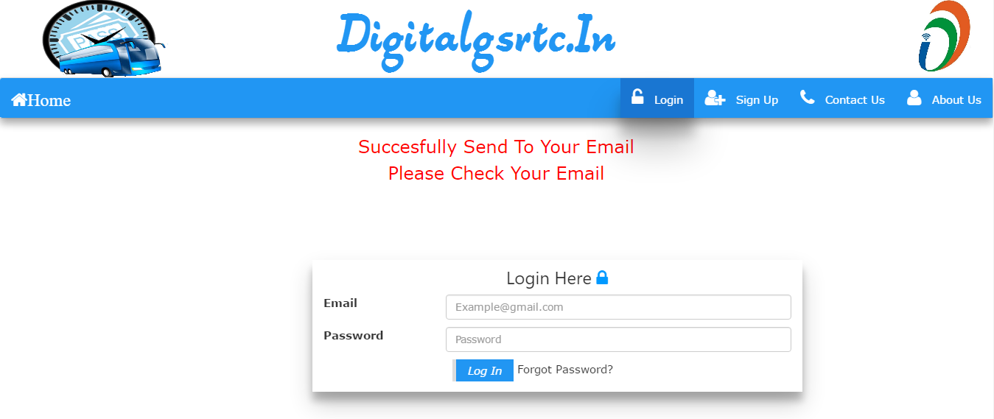
37

Slide 40
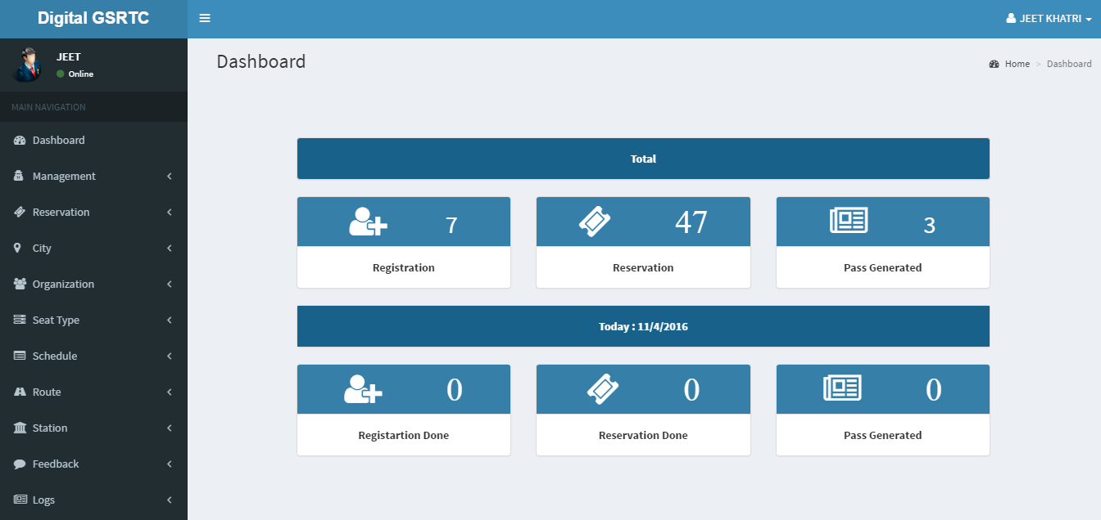
38

Slide 41
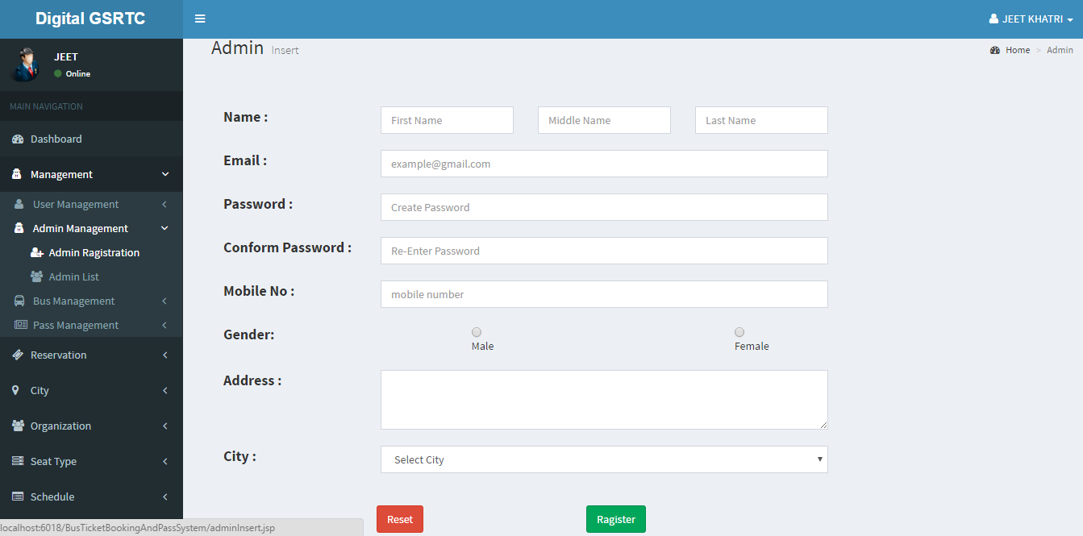
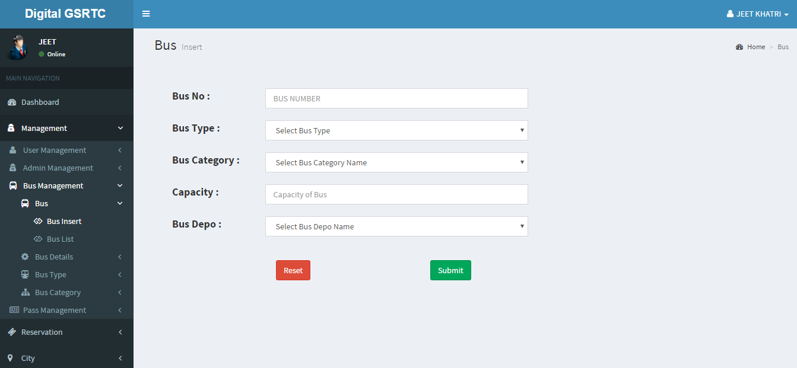
39

Slide 42
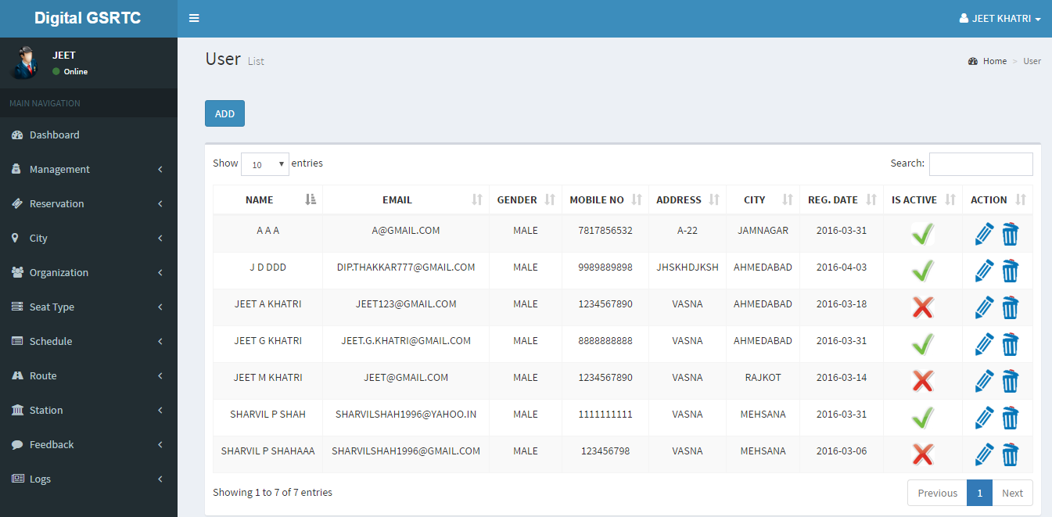
40

Slide 43
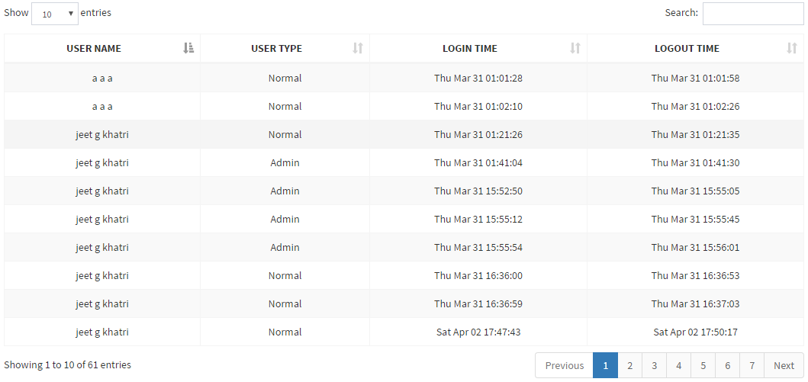
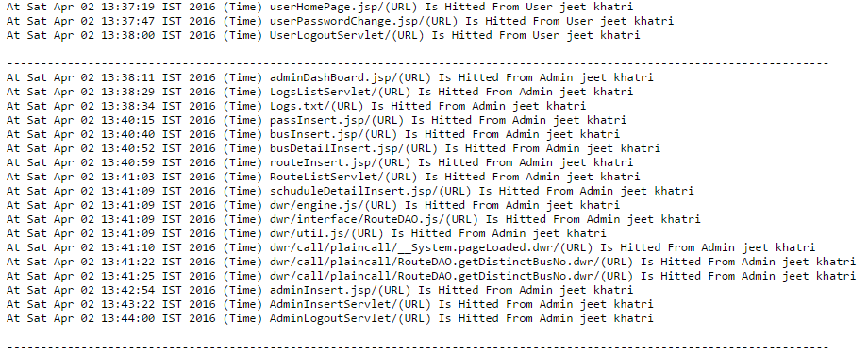
41

Slide 44


42

Slide 45
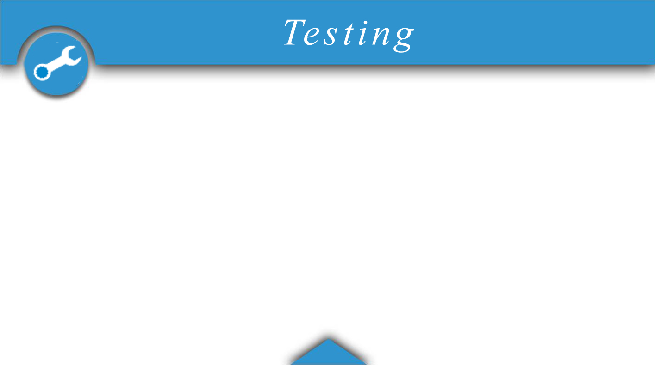
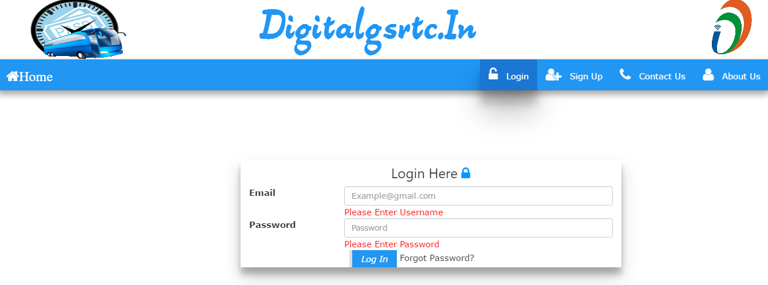
43

Slide 46
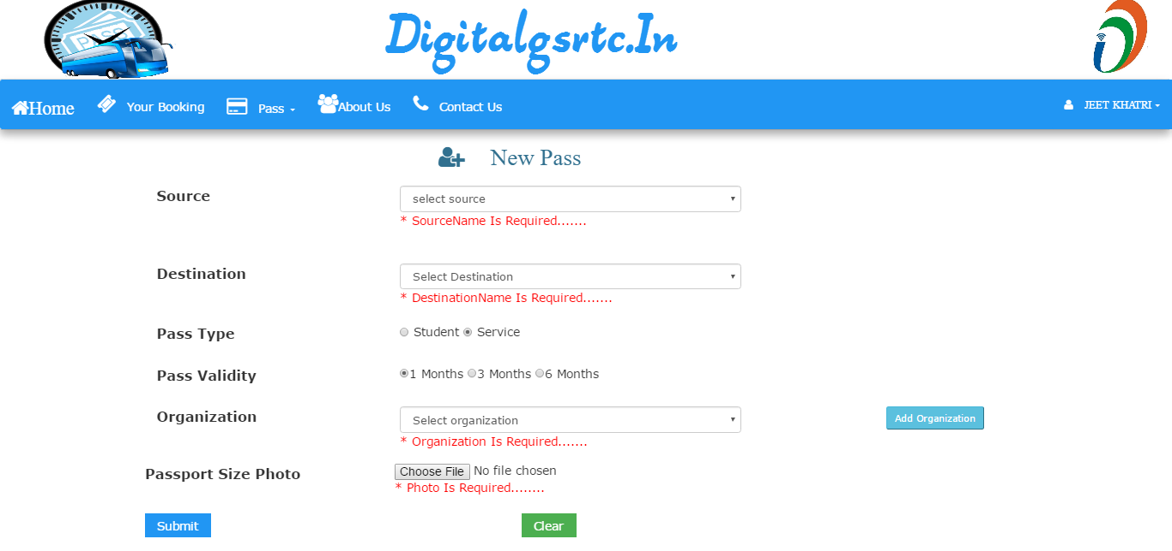
44

Slide 47


45

Slide 48

46

Slide 49

47

Slide 50

48

Slide 51

For student pass proof must be there of Government college ,in this system
Without proof it can be obtain
No sleeper bus’s reservation facility available
Schedule is maintained by different different sub admin.in this system there is no facility to add sub admin.
49

Slide 52

50

Slide 53

Waiting facility can be provided
Online payment
More functionality can be provided like download schedule image , schedule change text message , filters, etc.
51

Slide 54

52

Slide 55

Any Work may not always be perfect.
There may be some defects or errors. We have taken enough care to make the project user friendly and more interactive. Major focus is to make user-friendly system which can help to book ticket and get pass immediately.
Any suggestion to make this project more useful is Always most welcome.
53

Slide 56

54

Slide 57


